Slide 1
Sanjay Modgil
Director of Undergraduate Studies: Year one

Slide 2
How learning will work this year
Outline of how lectures, tutorials and labs are working
The College has said that students are expected to be on campus, if possible.
We understand that for many of our students, this will not be possible or preferable.
If you choose not to come to campus, we will ensure that you still receive the best possible teaching and support.

Slide 3
How learning will work this year
Outline of how lectures, tutorials and labs are working
Traditional lectures will be replaced by online, asynchronous resources for all modules.
The format of this will vary from module to module but could include:
Recorded material, split into 5-to-15-minute chunks
Reading of articles, book chapters etc.
Self-assessment activities

Slide 4
How learning will work this year
Outline of how lectures, tutorials and labs are working
Large-group tutorials (LGTs) will be online, live and interactive.
Small-group tutorials (SGTs) will be led by Teaching Assistants and will be live and interactive.
SGTs will vary from module to module. Some modules may only have SGTs every other week whilst others may have them every week.
Some modules may have the option of SGTs on campus (where this is the case, there will also be an online option for those not in London), whilst SGTs for other modules will be solely online, depending on type of module and the teaching content.
We will share the specifics of individual modules as soon as these have been confirmed.

Slide 5
How learning will work this year
Outline of how lectures, tutorials and labs are working
Detailed per module information is being documented to configure the software environment needed for lab- based teaching on your personal computer.
While installing the majority of software directly on your device will be possible we will recommend configuring a Linux based virtual machine for consistency with the NMS lab based environment.

Slide 6
How learning will work this year
Your Equipment Needs
The majority of teaching exercises will run on a modestly specced laptop or desktop computer. We will share with you shortly the minimum system requirements needed.
In case your computer does not meet these requirements options will be available to ensure you are provided with the necessary computing environment.
Some modules and projects may also require more computational resources. Again, in these cases a suitable hosted computing environment will be made available. More details will follow on these topics.

Slide 7
Assessment
Your modules will be assessed through coursework, examinations and participation in the course.
An overview of the assessment structure for each of your modules, can be found here: https://keats.kcl.ac.uk/mod/book/view.php?id=3259665&chapterid=276398
Further info will also be available on the KEATS page for each module.
Examinations for semester 1 modules in January will be held online.
A decision has not been made yet about whether examinations for semester 2 modules will also be online or face-to-face.

Slide 8
How to contact academic staff
KEATS Discussion Forum
For all questions about course content use the Discussion Forum first
Office Hours
Will be held online when you also ask about course content with your lecturer and talk to your personal tutor
Email
Only for private sensitive matters
Do not use Teams to contact lecturers

Slide 9
Study Skills for this year
Essential Digital Skills Programme
Skills for remote studying at King’s
KEATS, MS Teams, online citizenship
Available at https://www.kcl.ac.uk/teachlearntech/students
Remote Working and Studying Module
Skills for remote working and studying in Computer Science
GitHub, LaTeX, team working
Available on KEATS - 6CCSMRWS

Slide 10
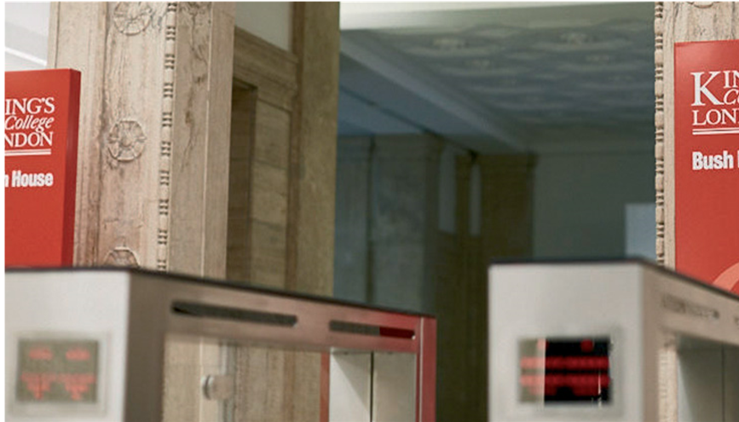
How to contact us
Department of Informatics
Bush House
Room BH (N) 6.11
30 Aldwych
London
WC2B 4BG
Department of Informatics office will not be
open initially, support will be provided via:
Email: ug-informatics@kcl.ac.uk
FAQs: These cover the most commonly asked questions. All students are asked to familiarize themselves with this document
KEATs Forums: This will cover common queries and specifics that need to be known in relation to upcoming activities
KEATs Chats: This will cover more immediate generic queries, that have not been answered by Student Services or FAQs
Booking virtual meetings: This will be for complex questions that require face to face support
Student Services: Email- Student services are most commonly used for non-programme specific questions and should be used
Microsoft Teams chat is not to be used to contact people directly as an alternative method.
Notes:
Initially, the Department of Informatics office will not be open due to Covid Safety measures. This decision has been taken by the Faculty of Natural & Mathematical Sciences after an assessment of resources, safety measures and how best to support the student experience. The department will be working with student reps to receive feedback and adjust reasonably to what students require in order to support their studies.
In order to contact the department professional services team, there will be a number of methods:
Email: This can be used for all queries. The department has a 5 day SLA during non-busy periods. Where we see multiple queries on the same topic, we may choose to send an email to all students in order to answer. Where the question is answerable via FAQs, we will ask students to check these. Please note, the PS team is here primarily to answer Programme related queries, where possible we will try to answer other queries but if we cannot then you will be directed to a relevant team.
FAQs: The department has a list of most commonly asked questions. We ask that all students check this to ensure that their query has not been answered here before contacting the department.
KEATs Forums:
KEATs Chats:
Booking Virtual Meetings: Where your query is complex and needs a specific face to face conversation, the PS team will direct you to either a booking form or will set up a meeting with you directly.
Student Services: Student Services have a query system that answers a lot of questions not related to programmes, for example X. This is often a quick and easy way to get answers and we do encourage students to use this service
Please note, the PS team will not respond to any queries that come in through Microsoft Teams chats. The only accepted contact method will be those outlined on this slide.

Slide 11

Who to contact
General admin queries: programme officer
Module query: module lecturer
General academic, personal or wellbeing query: personal tutor

Slide 12

Computer Credentials
K-number
Email, KEATS, Student Records, login to College computers
IT queries:
8888@kcl.ac.uk

